Slide 1
Project Meeting March 2026
GreenREFORM EU 2.0
25-03-2026
Jens Sand Kirk

Slide 2
Agenda
Project context and objectives
Activities and allocation
Timeline
Model development
Data & Implementation (support)
UCPH Vietnam Project
Capacity building

Slide 3
Project context and objectives
“KR Foundation engages in non-profit activities with positive impacts on our climate and environment, and support projects where neither governments nor market actors seem to have incentives to act.” KR-Foundation website
  Funded by the KR-foundation (66,500 EUR), which also provided partial funding for the original GreenREFORM DK University research project.
  Builds on GreenREFORM (Denmark) and the GreenREFORM EU project of 2024-2024 funded by the EU.
  Objective: maintain momentum and support four partner institutions in (Austria, Finland, Belgium, Italy) to calibrate and use the model.
  New partnership: University of Copenhagen (UCPH) to support adaptation for Vietnam (separate headline activity).
  Timing priority: Aim to complete by October 2026 to minimise overlap with TSI 2026 (starts Sep 2026).

Slide 4
Agenda
Project context and objectives
Activities and allocation
Timeline
Model development
Data & Implementation (support)
UCPH Vietnam Project
Capacity building

Slide 5
Activities and allocation

Slide 6
Activities and allocation

Slide 7
Agenda
Project context and objectives
Activities and allocation
Timeline
Model development
Data & Implementation (support)
UCPH Vietnam Project
Capacity building

Slide 8
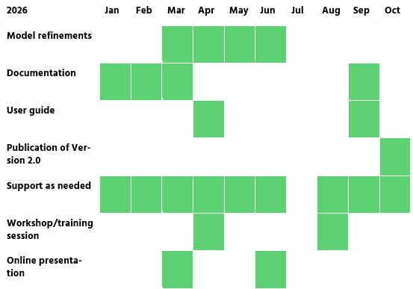
Timeline

Slide 9
Agenda
Project context and objectives
Activities and allocation
Timeline
Model development
Data & Implementation (support)
UCPH Vietnam Project
Capacity building

Slide 10
Model development
Now:
Documentation
Abatement model
Model structure
Next:
Data and calibration
Energy markets
Later:
User guide
Publish

Slide 11
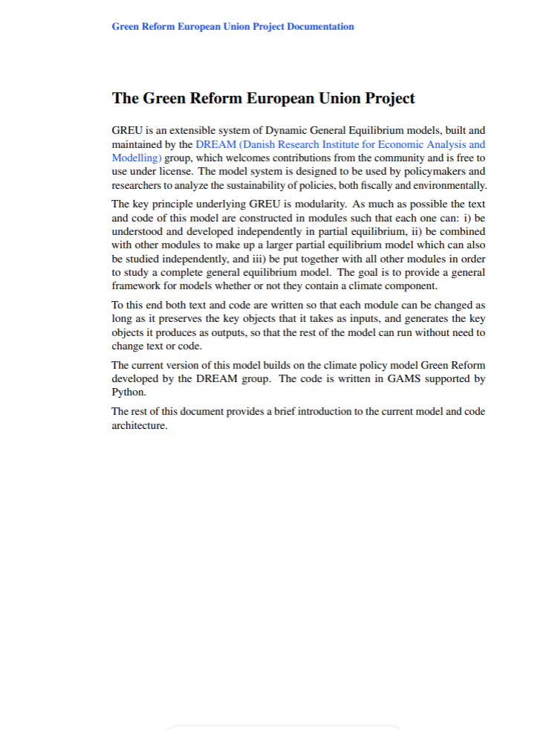
Documentation
Draft version available in Teams workspace
Feedback is most welcome !
Goals:
  Allow an overview of the entire project.
  Provide intuition on some of its technical details.
  Guide users through the process of using and adapting the model to their specific needs.
Current Status:
  The structure is in place.
  Work is under way regarding
    Details and remaining chapters
    Data
    Modularity (how the different parts of the model connect).

Slide 12
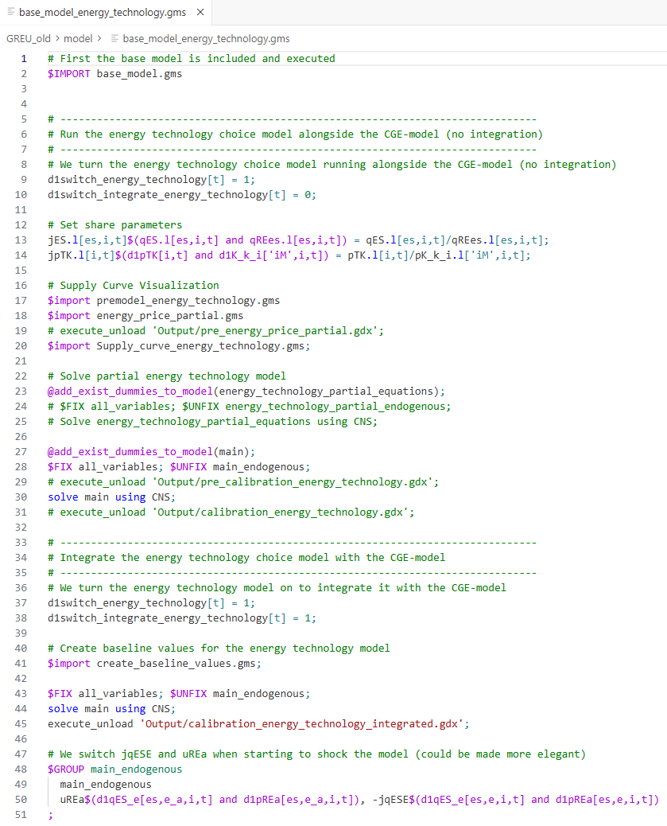
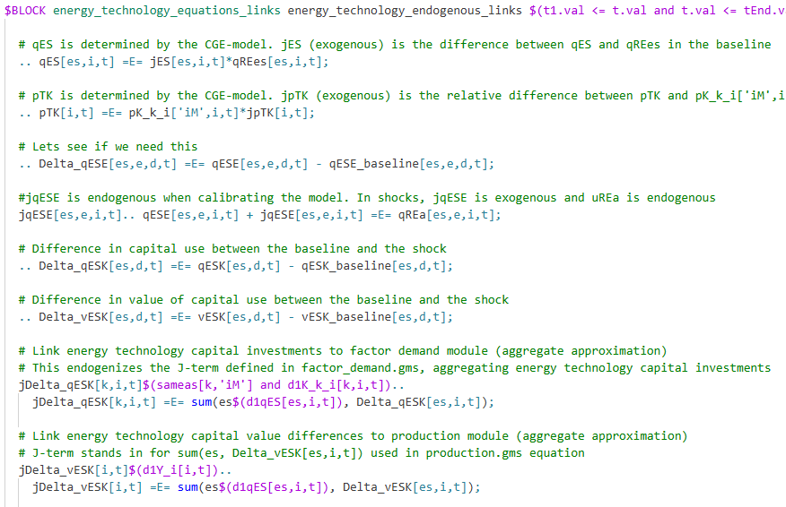
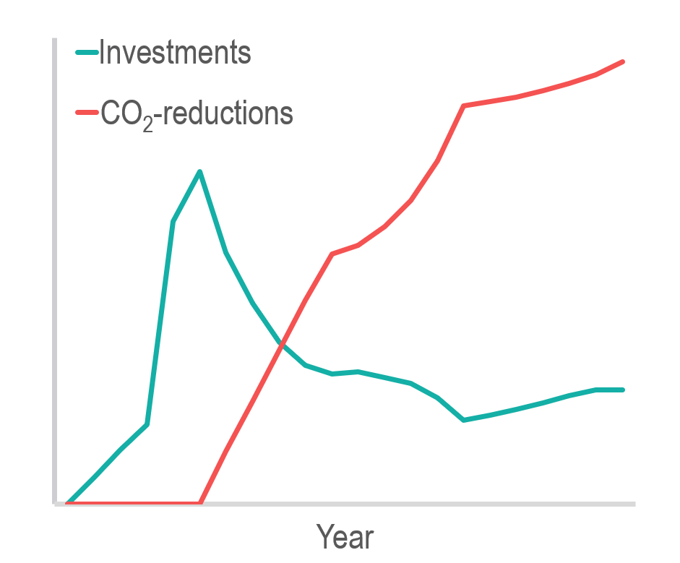
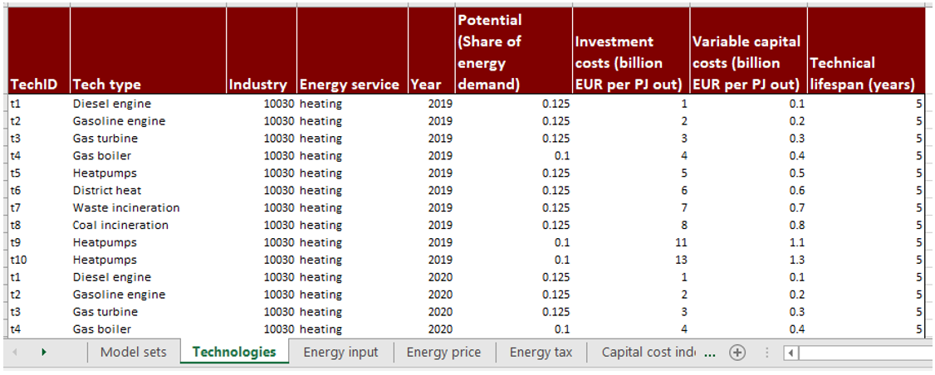
Energy technology model
(Formerly known as ”abatement”)
The ambition in Belgium is to integrate technology data from TIMES into the model during this year
Development projects:
Renaming from ”abatement” to ”energy technology”
Excel-based module for technology data
Improved structure
Improved integration with rest of the model
(Frontloaded investments)

Slide 13
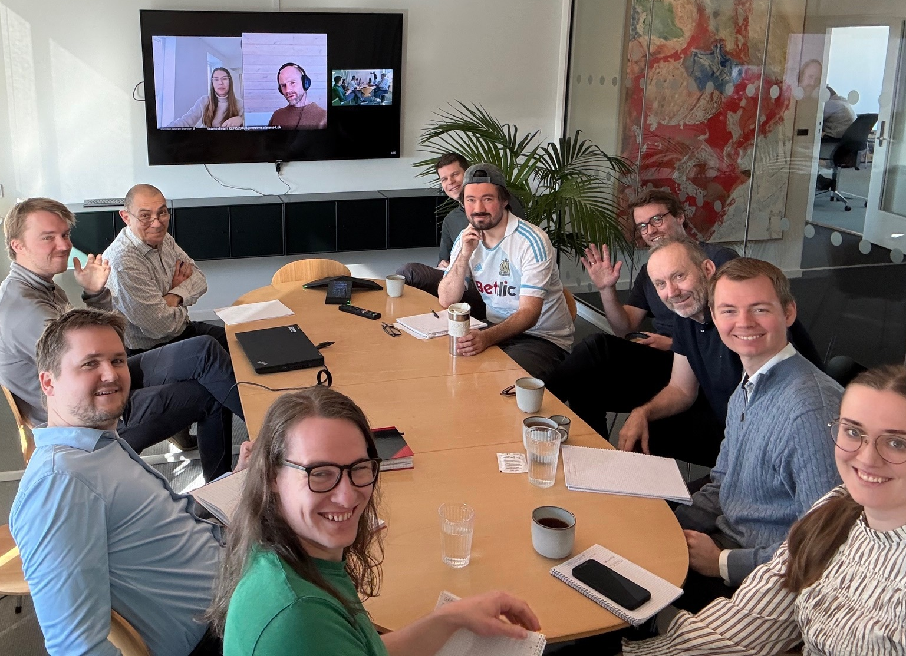
Model structure
12 people are currently engaged in the model development !
In a seperate project for the Faroe Islands, The ‘Green’ in ‘GreenREFORM EU’ is being replaced by ‘Fiscal’ in support of analysis of Fiscal Sustainability etc.
More similar projects on the horizon..
A lot of effort is being put into improving the modularity and general structure, as we aspire to maintain a common model core.
‘Green’ users will get a lot of model advancements for free.
Keeping up with frequent updates om Github will be challenging.

Slide 14
Agenda
Project context and objectives
Activities and allocation
Timeline
Model development
Data & Implementation (support)
UCPH Vietnam Project
Capacity building

Slide 15
Data & Implementation (support)
Country | Objectives | Support
Austria | Build reproducible scripted data pipeline; set data structures | Pipeline/process design, documentation standards, training workshops.
Belgium | Make model operational on Belgian data; populate abatement technology catalogue; integrate with TIMES model. | Calibration guidance, error resolution, best-practice exchanges.
Finland | Complete national dataset (FinReform, 2019 base) Q1 2026; initial calibration & pilot analyses on environmental taxation and transport fuels. | Technical guidance on data aggregation, calibration help, interpretation assistance during pilots.
Italy | Harmonise national accounts and energy balances; exploratory policy shock tests by Q4 2026. | Methodological guidance on aggregation, colleague exchanges, calibration parameter sharing.

Slide 16
Austria: Goals and Challenges
Clear goal: Be in the best possible position to take advantage of GreenREFORM 2.0 when the TSI starts
This means:
  Create a data pipeline that can rely on existing, publicly available data (ideally for mutliple countries)
  Using this data pipeline, be ready to calibrate the model this year
  Take advantage of DREAM‘s support and experience to define process steps and necessities
  Spread the word within the government (internal workshops, AT specific documentation) to ensure wide distribution

Slide 17


Belgium: Ambitions & objectives
Use in study on green transformation of Belgian industrial sector
scenarios on industrial development
Implications for the energy system
Two approaches:
Top-down linking with energy-system model (TIMES)
Integrated technology catalogues in GreenREFORM-BE
17
25. marts 2026
Data & Implementation (support)

Slide 18

Belgium– Status GreenREFORM-BE
Completed
Baseline calibration of the CGE model
Simulating a simple shock
Abatement model with generic BE data
Ongoing/planned
Technology catalogues for top 6 polluting sectors
Integrated energy technology model
3 scenarios with exogenous shocks
18
25. marts 2026
Data & Implementation (support)

Slide 19



Status GreenREFORM-BE: abatement module
Robust Python script
  Takes into account inflation
  Splits technologies with capacity above treshold
  Flexible time horizon
TIMES database
Production routes TIMES
Tech catalogues
Processes to
production route
19
25. marts 2026
Data & Implementation (support)

Slide 20
Agenda
Project context and objectives
Activities and allocation
Timeline
Model development
Data & Implementation (support)
UCPH Vietnam Project
Capacity building

Slide 21
UCPH Vietnam Project
Project title: Promoting Green Reforms in a Rapidly Industrializing Country: Energy Transition and Climate Smart Development in Viet Nam
Budget: DKK 4.8 million
Project period: Two-year period from 1 January 2026 to 31 December 2027
Grantor: the Danish Ministry of Foreign Affairs (MFA)
Grantee: the University of Copenhagen Developments Economics Research Group (UCPH-DERG)
Vietnamese collaborating institutions:
  Institute of Policy and Strategy Studies (IPSS)
  National Institute for Economics and Finance (NIEF)
  Institute of Strategy and Policy on Agriculture and Environment (ISPAE)

Slide 22
Project objectives
Bring together Danish modelling expertise to support Vietnam’s growth targets and enable integrated assessments of economic, environmental, and climate policies
Develop a customized dynamic GreenReform model for Vietnam with upgraded 2024 SAM data, population forecasts, and technology catalogues
Analyze reform pathways and development scenarios to assess socio-economic and climate impacts and support evidence-based policymaking
Build capacity in key Vietnamese institutions and generate lessons relevant for other developing countries

Slide 23
Agenda
Project context and objectives
Activities and allocation
Timeline
Model development
Data & Implementation (support)
UCPH Vietnam Project
Capacity building

Slide 24
Capacity building
No planned activities yet – your suggestions are most welcome !
Allocation: 5 work days
Envisioned activities
Online workshops and training sessions (scheduled ~every 3 months).
Tailored, individualized support to each participating institution.
Introductory online presentations for new personnel and prospective partners.

Slide 25
Final thoughts

